Slide 1
EMPLOYEE DATA ANALYSIS USING EXCEL
STUDENT NAME : R.SUVATHI
REGISTER NO : 312209022
DEPARTMENT : BACHELOR OF COMMERCE (GENERAL)
COLLEGE : CHEVALIER T. THOMAS ELIZABETH
COLLEGE FOR WOMEN

Slide 2
PROJECT TITLE :
Employee Performance Analysis using Excel

Slide 3
AGENDA :
Problem Statement
End Users
Project Overview
Our Solution and Proposition
Dataset Description
Modelling Approach
Results and Discussion
Conclusion

Slide 4

PROBLEM STATEMENT :
Analyze employee performance using Excel by evaluating key performance indicators (KPIs) such as productivity, punctuality, and quality of work. Identify patterns, trends, and outliners in employee data to determine high and low performers.

Slide 5

PROJECT OVERVIEW :
This project aims to analyze employee performance using Excel by comparing gender differences in performance scores, achievements, and target attainment. The analysis will identify trends and disparities, providing insights for improving equality ad productivity. A summary of the findings will be presented in an Excel dashboard. Key metrics like average performance scores, achievements rates, and target fulfillment will be compared across genders. The analysis will utilize various Excel tools, such as pivot tables, filter, slicers, charts, and statistical functions, to explore and visualize the data

Slide 6
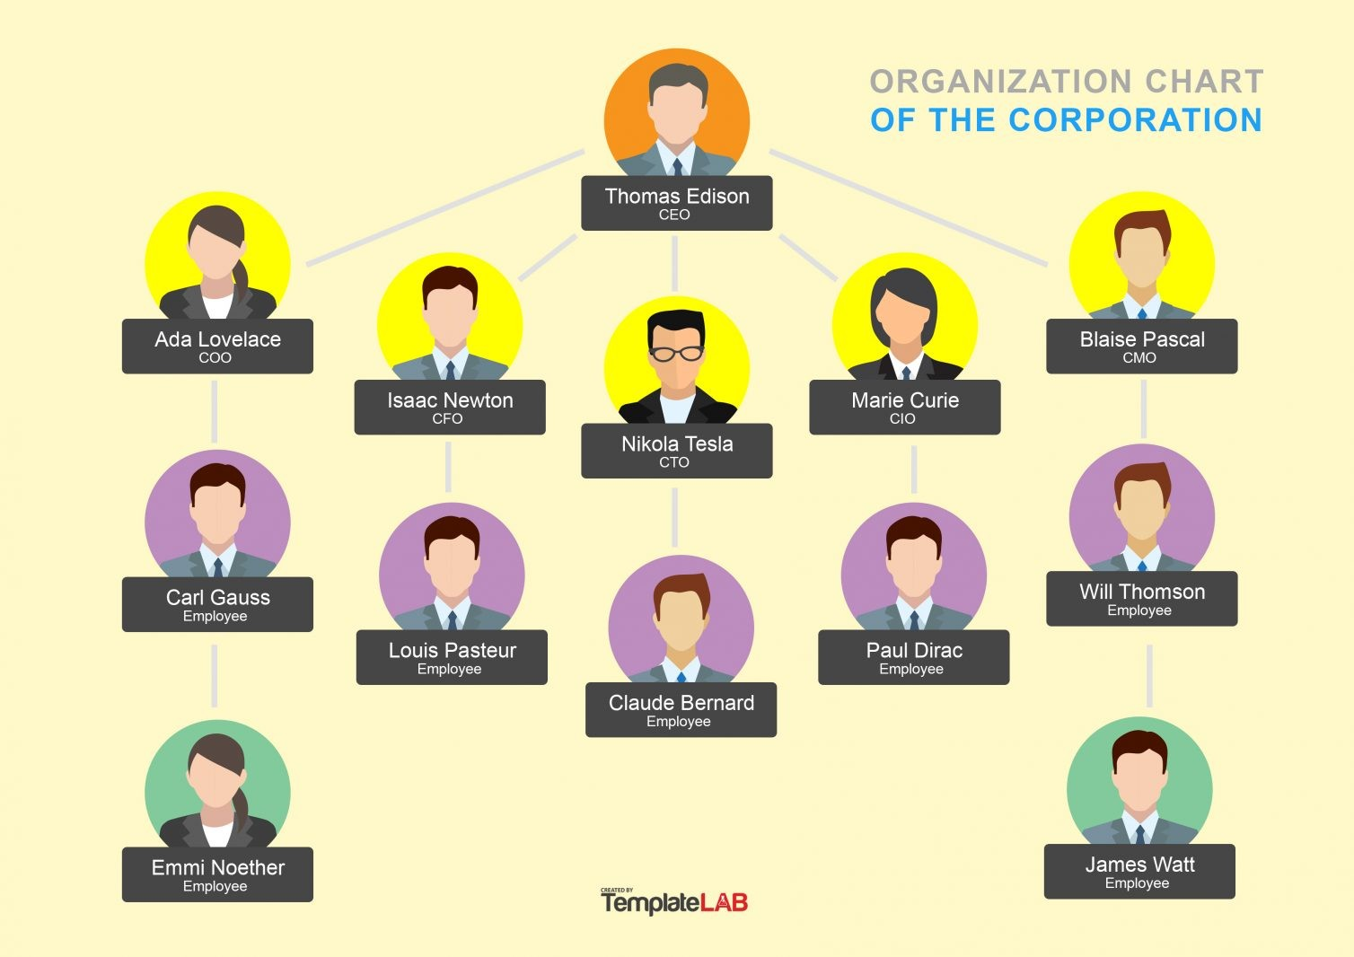
WHO ARE THE END USERS ?
Executive Management
HR Managers and HR Analysts
Team Leaders and Department Heads
HR Business Partners
Employees

Slide 7
OUR SOLUTION AND ITS VALUE PROPOSITION :
Conditional formatting – Missing
Filter – Remove
Formula – Performance
Pivot table and chart – Summary
Graph – Data visualization

Slide 8
Dataset Description : Employee → Kaggle 26 → Features 9 → Features Employee id → Number Name → Text Employee type Performance level Gender → Male, Female Employee rating → Number

Slide 9

THE "WOW" IN OUR SOLUTION :
Performance level = IFS(Z8>=5,”very high”,Z8>4,”HIGH”,Z8>=3,”MED”,TRUE,”LOW”)
3/21/2024 Annual Review

Slide 10
MODELLING :
DATA COLLECTION :
1) Kaggle downloaded
2) Gather data from relevant sources like hr database, performance reviews, attendance records, and project outcomes.
3) Include metrics such as work hours, task completion rates, feedback scores, and sales numbers.
FEATURE COLLECTION :
1) Identify key performance indicators ( KPIs) that are critical to assessing employee performance. these may include:
2) → Productivity ( eg., number of tasks completed )
→ Quality of work ( eg, error rates )
→ Punctuality ( eg., attendance and timeliness )
→ Collaboration ( eg, team feedback )
DATA CLEANING :
1) Clean the data by removing duplicates, handling missing values, and

Slide 11
correcting any data entry errors. 2) Standardize data formats ( eg., date formats, numerical values ) PERFORMANCE LEVEL CLASSIFICATION : 1) Categorize employees into different performance levels ( eg., High, Medium, Low ) based on the selected KPIs. 2) Use Excel functions like IF, VLOOKUP, or INDEX and MATCH to automate this classification. SUMMARY : 1) Create summary tablrs that provide an overview of performance across different teams, departments, or time periods. 2) Use Excel’s PivotTables to quickly aggregate and summarize data by category. VISUALIZATION : 1) Develop visual representation of the data using Excel charts and grapghs. 2) Use bar charts, line graphs, and heat mas, to illustrate performace trends, comparison among different groups, and highlight key areas for improvement.

Slide 12
RESULTS :

Slide 13
Results :

Slide 14
Conclusion : The employee performance analysis using Excel indicates that medium-level employees are consistently performing at a high level, contributing significantly to overall productivity. However, there is a noticeable gap between their performance and that of other employee groups. To achieve better outcomes across the board, it is crucial to motivate and support lower-performing employees. Purple color indicates high , blue color indicates low , green color indicates medium , yellow color indicates very high . in the chart, medium is in first position, low is in second position , high is in third position, very high is in fourth position . by addressing this gap, w can create a more balanced and high-performing team that drives greater overall success for the organization.

